Slide 1



Twitter analysis of
Andrew Yang
By Andrew Wu

Slide 2
Project Workflow
01.
02.
03.
04.
Tweet Collection
Text Preprocessing
Twitter API(tweepy)
getOldTweets
Tokenizing, n-grams, stop words
TF-IDF
Sentiment Analysis
Topic Modeling
TextBlob
NMF
Visualized with MDS
1

Slide 3
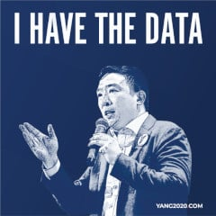
Tweets
Collection
2

Slide 4
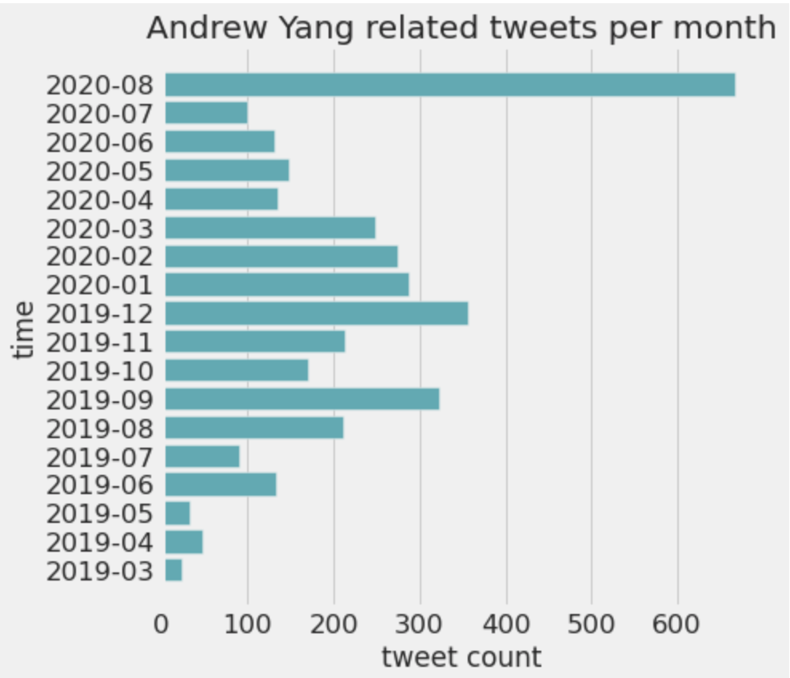
The data
3585 tweets after removing retweets and duplicates
Spans over a year and a half(earliest record to most recent)
DNC
announcement
6th Dem debate
3rd Dem debate
3

Slide 5
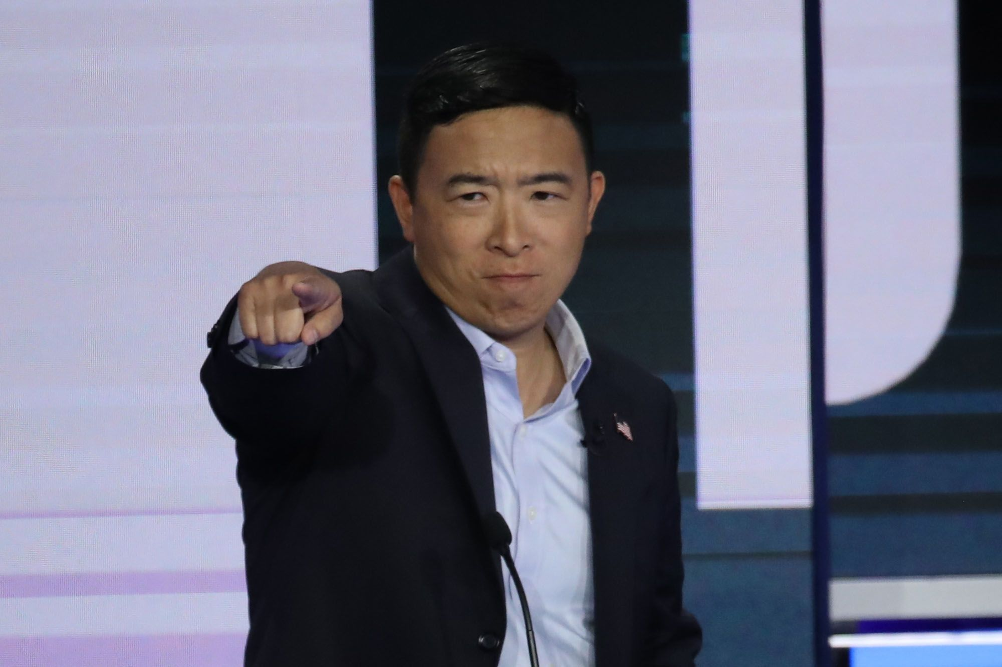
Data
Pre-
processing
4

Slide 6
Tweets are messy, extensive text cleaning is required
Clean
Tokenize
Vectorize&Lemmatize
Uni & bi-grams
Remove hyperlinks, punctuations.
Remove emojis,hashtags, @
Customized list
Spell check
5

Slide 7
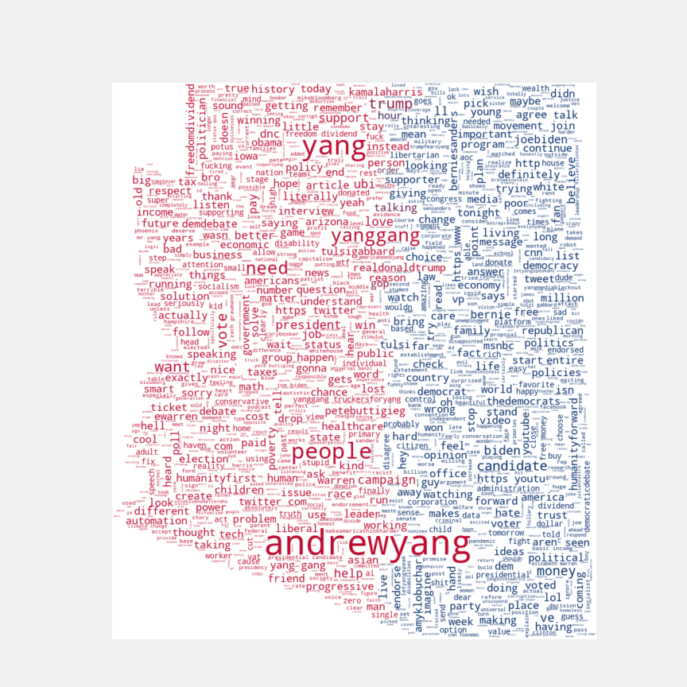
WordCloud
6

Slide 8
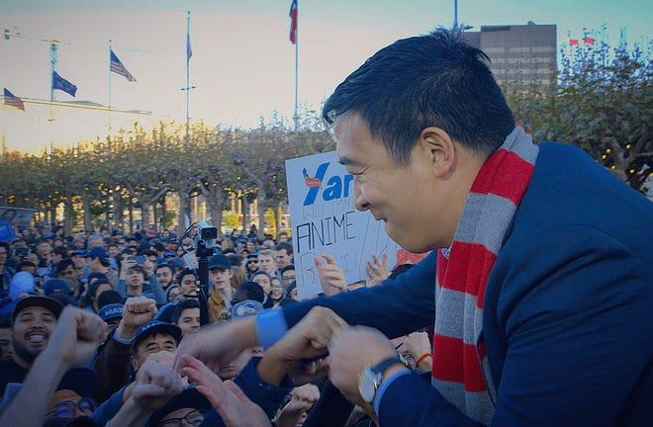
Sentiment
Analysis
7

Slide 9
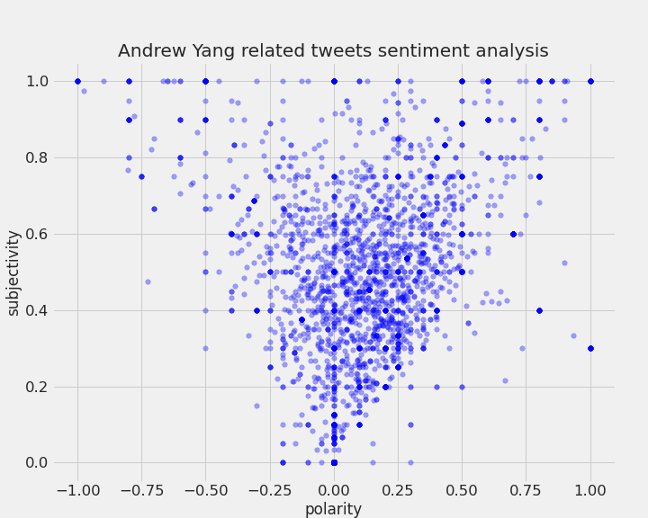
Overall: Arizonans have a positive view towards Yang
More opinionated
Less opinionated
8
Negative
Positive

Slide 10
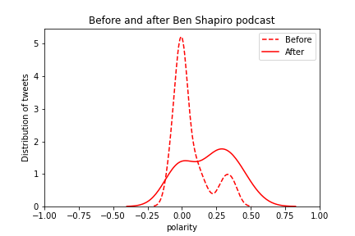
Arizonans respond more positively when Yang appears in right-wing related news
9

Slide 11
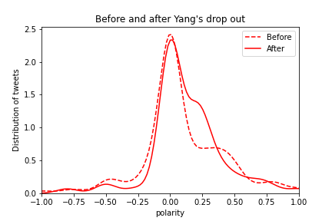
Arizonans respond more positively when Yang appears in right-wing related news
10

Slide 12
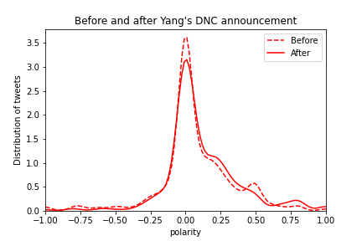
Arizonans respond more positively when Yang appears in right-wing related news
11

Slide 13

Topic Modeling
12

Slide 14
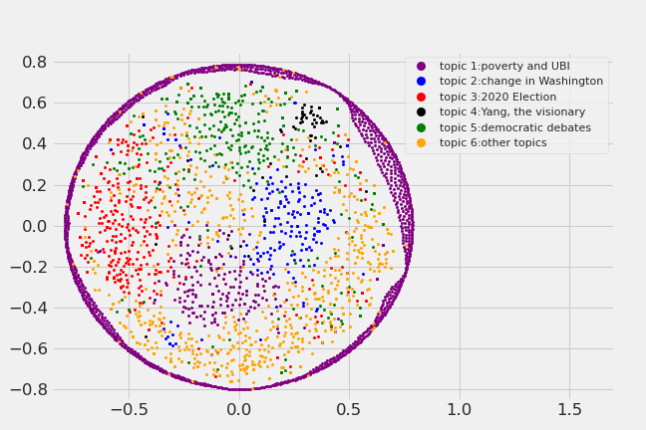
UBI is often associated with poverty
Most frequent: Poverty and UBI with 1500 tweets
Least frequent:
Yang, the visionary with 100 tweets
13

Slide 15
Deeper look at the topics
Poverty and UBI:
Associated sub-topics: people, job, life, UBI, humanity, America, income, country
Yang, the visionary:
Associated sub-topics: love, election, forward, math, hope, America, humanity
14

Slide 16
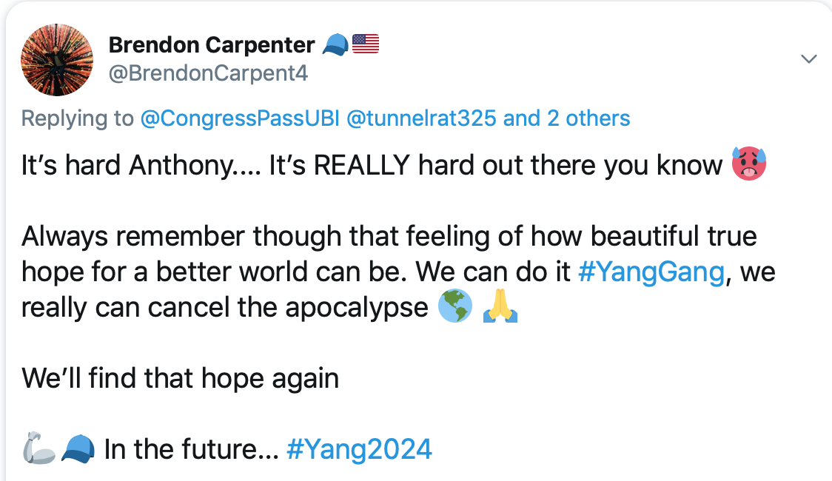
Tweet tracing demonstration:
Yang, the visionary
Associated sub-topics: love, election, forward, math, hope, America, humanity
15

Slide 17
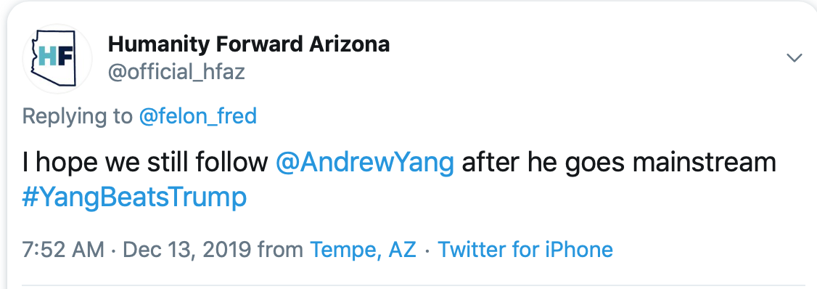
Tweet tracing demonstration:
Yang, the visionary
Associated sub-topics: love, election, forward, math, hope, America, humanity
16

Slide 18
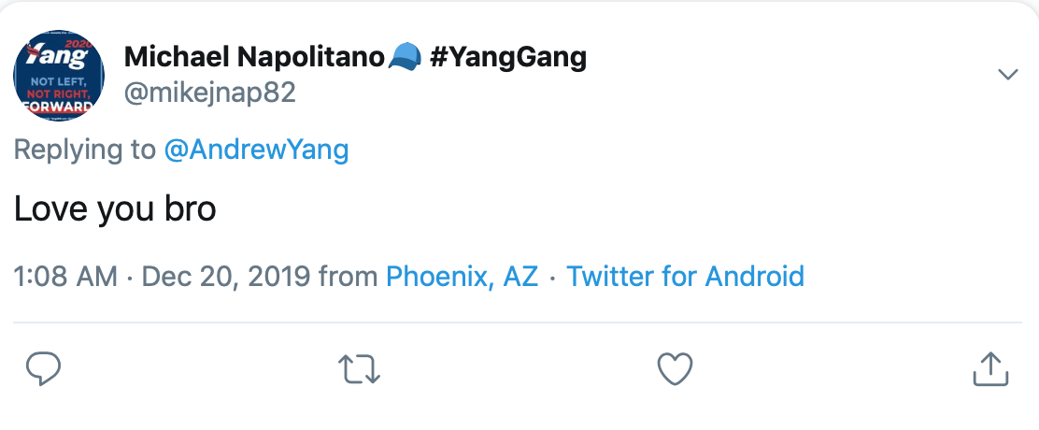
Tweet tracing demonstration:
Yang, the visionary
Associated sub-topics: love, election, forward, math, hope, America, humanity
17

Slide 19
Future work
Try new topic modeling techniques to try to get better topics
Live twitter feed, real time analysis
Obtain geo-location from twitter API and create city based, more specific
sentiment analysis
18

Slide 20
Thank You! Any Questions?
Linkedin:
https://www.linkedin.com/in/andrew-wu-939746171/
Github:
https://github.com/andywzz?tab=repositories

Slide 21
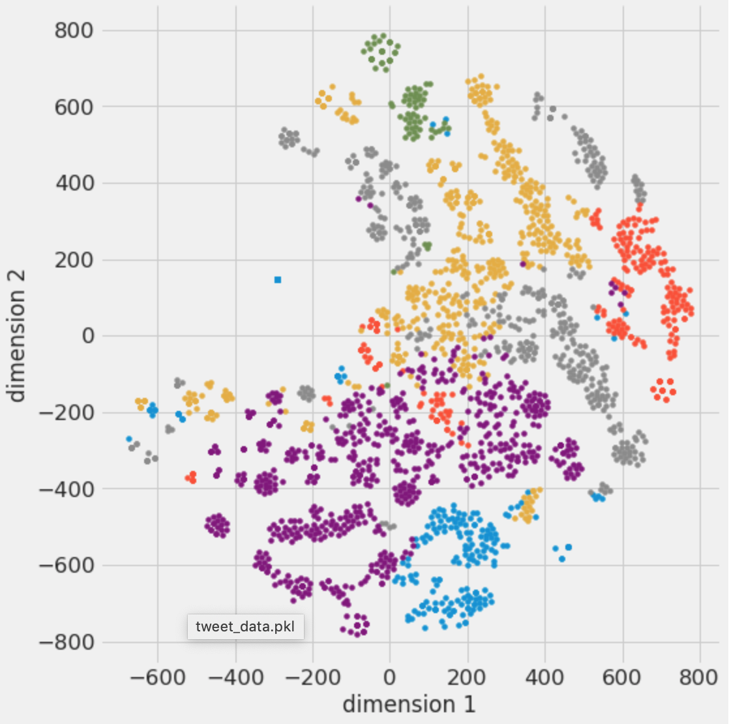
APPENDIX
19

